Slide 1
INT219 FRONT END WEB DEVELOPER
Lecture #0
The kick start session

Slide 2
Course Details
Course Code:- INT219
LTP:- 2 0 2 [2 lectures, 2 practical's /week]
Credits:- 3

Slide 3
Vision
To be a globally recognized school through excellence in teaching, learning and research for creating Computer Science professionals, leaders and entrepreneurs of future contributing to society and industry for sustainable growth.

Slide 4
Mission
To build computational skills through hands-on and practice-based learning with measurable outcomes.
To establish a strong connect with industry for in-demand technology driven curriculum.
To build the infrastructure for meaningful research around societal problems.
To nurture future leaders through research-infused education and lifelong learning.
To create smart and ethical professionals and entrepreneurs who are recognized globally

Slide 5
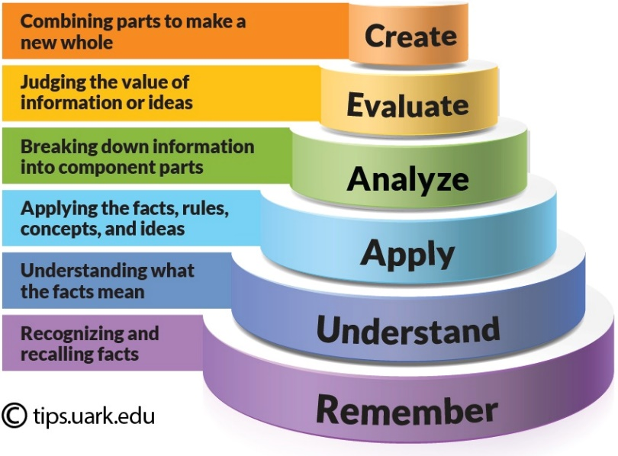
Revised Bloom’s Taxonomy
Bloom's Taxonomy is a framework for categorizing educational goals, It is widely used by educators to create learning objectives, assessments, and activities that encourage higher-order thinking. The taxonomy is typically represented as a hierarchical model with six levels:
Remembering: Recalling facts and basic concepts.
Example: Define, list, memorize, repeat, state.
Understanding: Explaining ideas or concepts.
Example: Describe, explain, interpret, summarize, classify.
Applying: Using information in new situations.
Example: Use, execute, implement, demonstrate, solve.
Analyzing: Breaking information into parts to explore understandings and relationships.
Example: Compare, contrast, examine, test, differentiate.
Evaluating: Justifying a decision or course of action.
Example: Critique, judge, argue, support, validate.
Creating: Producing new or original work.
Example: Design, construct, plan, produce, invent.

Slide 6
Course outcome
Through this course students should be able to:
CO1 :: apply basic HTML elements, CSS properties and Tailwind to create visually appealing web
pages.
CO2 :: create webpage using Tailwind CSS Concepts, Layout,Spacing, Sizing and Typography.
CO3 :: understand use JavaScript variables, functions, and events to enhance user interactivity
on web pages.

Slide 7
Course outcome
Through this course students should be able to:
CO4 :: evaluate HTML elements, handle events, and create dynamic web content using JavaScript and DOM.
CO5 :: create interactive web forms and validate user input to enhance form handling.
CO6 :: apply jQuery for efficient element manipulation and work with JSON objects for seamless data exchange.

Slide 8
Program Outcomes
PO1 Engineering knowledge: Apply the knowledge of mathematics, science, engineering fundamentals, and an engineering specialization to the solution of complex engineering problems.
PO2 Problem analysis::Identify, formulate, research literature, and analyze complex engineering problems reaching substantiated conclusions using first principles of mathematics, natural sciences, and engineering sciences.
PO3 Design/development of solutions::Design solutions for complex engineering problems and design system components or processes that meet the specified needs with appropriate consideration for the public health and safety, and the cultural, societal, and environmental considerations.
PO4 Conduct investigations of complex problems::Use research-based knowledge and research methods including design of experiments, analysis and interpretation of data, and synthesis of the information to provide valid conclusions.

Slide 9
Program Outcomes
PO5 Modern tool usage::Create, select, and apply appropriate techniques, resources, and modern engineering and IT tools including prediction and modeling to complex engineering activities with an understanding of the limitations.
PO6 The engineer and society::Apply reasoning informed by the contextual knowledge to assess societal, health, safety, legal and cultural issues and the consequent responsibilities relevant to the professional engineering practice.
PO7 Environment and sustainability::Understand the impact of the professional engineering solutions in societal and environmental contexts, and demonstrate the knowledge of, and need for sustainable development.
PO8 Ethics::Apply ethical principles and commit to professional ethics and responsibilities and norms of the engineering practice.
PO9 Individual and team work::Function effectively as an individual, and as a member or leader in diverse teams, and in multidisciplinary settings.

Slide 10
Program Outcomes
PO10 Communication::Communicate effectively on complex engineering activities with the engineering community and with society at large, such as, being able to comprehend and write effective reports and design documentation, make effective presentations, and give and receive clear instructions.
PO11 Project management and finance::Demonstrate knowledge and understanding of the engineering, management principles and apply the same to one’s own work, as a member or a leader in a team, manage projects efficiently in respective disciplines and multidisciplinary environments after consideration of economic and financial factors.
PO12 Life-long learning::Recognize the need for, and have the preparation and ability to engage in independent and life-long learning in the broadest context of technological change.

Slide 11
Skill Attainment
Technical Skills:
HTML CSS and JavaScript
Tailwind CSS and GitHub
DOM and JQuery
Soft Skills:
Creativity, Time management, Adaptability.
Problem-solving, Continuous Learning.

Slide 12
Course contents
Unit I
Introduction to HTML and CSS : Fundamentals of HTML, Creating Style Sheet, CSS Box Model Border properties, CSS selectors like type, id, class, Types of CSS, CSS Grid introduction, Creating different layouts for webpage, Introduction to GitHub and repository hosting
Unit II
Introduction to Tailwind CSS:-Core Concepts and Layout : Tailwind CSS Display and Visibility, Tailwind CSS Float, Tailwind CSS Clear, Tailwind CSS Layout, Tailwind CSS Z-index, Tailwind CSS Object Fit and Object Position, Tailwind CSS Flex, Tailwind CSS Grid, Justify and Align, Overview of Tailwind CSS., Tailwind CSS Container, Tailwind CSS Sizing

Slide 13
Course contents
Unit III
Styling and Enhancements:-Spacing, Sizing, Typography : Tailwind CSS Alignment, Tailwind CSS Spacing, Tailwind CSS Sizing, Tailwind CSS Typography, Tailwind CSS Backgrounds
Unit IV
Core JavaScript Fundamentals and Interactivity : Incorporating JavaScript in the HEAD and BODY element, Using an External JavaScript file, Variables and Operators, Control Statements, Looping Statements, Popup Boxes, JavaScript Objects, Working with Functions

Slide 14
Course contents
Unit V
DOM Manipulation and JavaScript Web Forms : Introduction to the DOM and its role in web development, Accessing and manipulating DOM elements using JavaScript., Programming HTML DOM with JavaScript, Modifying HTML content and attributes through JavaScript., Dynamic styling and manipulation of elements., Event Handling in JavaScript, Assigning event handlers using DOM object properties., Using addEventListener and removeEventListener for event management., Understanding and implementing event bubbling in JavaScript., Creating an interactive image gallery using DOM manipulation and event handling, Implementing thumbnail previews and lightbox-style image display., Fetching and displaying user location using the Geolocation API., Handling permission requests and errors with geolocation.
Unit VI
Working with jQuery and JSON : Basics of jQuery, jQuery Events, Benefits of using CDN, jQuery Selectors, jQuery input vs :input, jQuery DOM manipulation methods, jQuery Elements, Working with JSON Objects, JSON Arrays, Nested JSON object, Conversion of JSON object to string, Conversion of string to JSON object, jQuery DOM manipulation methods Working with JSON Objects, Introduction to revenue generation based project

Slide 15
List of practical's
Design web page using table and list concept in HTML.
Design web page using images, links and frames in HTML.
Design forms and perform various types of validations in HTML.
Design attractive web page using CSS and JavaScript.
Implement the concept of event handlers in JavaScript using DOM object property
Implement event bubbling in JavaScript.
Make Image gallery with thumbnails in JavaScript
Design web page using jQuery Selectors and elements.
Use JSON objects, arrays and string concept in your web pages.

Slide 16
List of practical's
Design customizable website using Bootstrap Grid System and Typography.
Implement Bootstrap list, table, buttons and dropdowns.
Create a Responsive Portfolio Section using Tailwind CSS
Create a Responsive Contact Form using Tailwind CSS
Create a JavaScript file (script.js) to handle the geolocation functionality

Slide 17
Assessment/Evaluation Scheme
Attendance: 5%
CA: 45%
MTT: No MTT
ETP: 50%

Slide 18
Assessment/Evaluation Scheme
CA1: 30 marks (Visual Implementation)
CA2: 30 marks (Project)
Note: No MOOC Certification is Applicable

Slide 19
CA 3 – Project Rubrics
Functionality (5),
User Interface(5),
Report (10),
Presentation(10),
Optional
Client Involvement component with Revenue Generation will be given opportunity to earn upto 10 marks.

Slide 20
Software's
Standard Editor :-
VS-Code.
Online Editor :–
CodeSandbox
CodePen

Slide 21
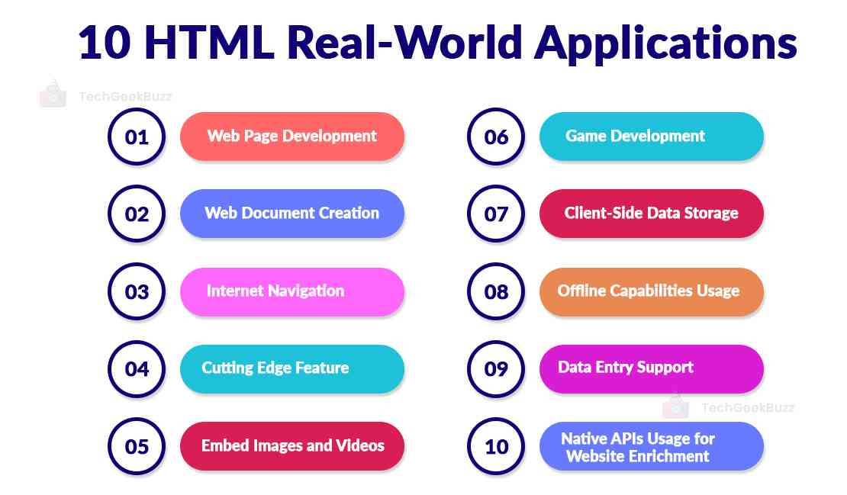
Real World Applications

Slide 22

EDU Revolution: Be the Change
New Year
New Beginning
New Excitement

Slide 23
Happy New Year Welcome to the New LPU
Learning by doing,
Application-based concept elaboration,
Learning beyond classrooms,
Activity-based assessments and project driven learning
Less Ppts and more interactive Classroom teaching
Experiential learning and Many More Initiatives

Slide 24
Happy New Year New Year, New Beginning, New Excitement Welcome to the New LPU
Simulation Based Lectures
Speaking Assessments
Case study-based Assignments
Less Ppts and more interactive Classroom teaching
Segmented Labs
Experiential learning and Many More Initiatives

Slide 25
What's New
Good Bye to old fashioned teaching and evaluation and let’s embrace the new paradigm Edu-Revolution: - Be the Change
Register to avail Privileges and benefits for the following Initiatives
A. Course Equivalence and Attendance Relaxation
B. Grade Revision and Overall Welfare (GROW)
C. 10 % Attendance waiver for students in Pre-final/Final year of the programme
D. Continuous Assessment Reduction Through Experience (CARE)
E. Students in active decision-making through Student Committees

Slide 26
Course Equivalence and Attendance Relaxation
Recognition of Prior Learning (RPL)
NPTEL Course/MOOCs/Certifications
Pursuing Project
Any other: In addition to above, the students may also suggest any additional aspect with regard to which the student is seeking course equivalence and attendance relaxation in the upcoming term

Slide 27
Recognition of Prior Learning (RPL)
Inform students about the concept of recognition of prior learning for basic elementary courses such as English, Mathematics, Analytical skills, Soft skills

Slide 28
NPTEL Course/MOOCs/Certifications
Enlist the MOOCs/Certifications applicable for the course
Encourage students to register for NPTEL/MOOCs/Certifications
Discuss the benefits associated with these courses (course equivalence and attendance relaxation)

Slide 29
Projects
Enlist short live projects that can be undertaken by the students
Guide students about the outcomes of the projects like Patent/Copyright/Publication/Industry funding/ Government sponsorship (like ATAL Innovation Mission)

Slide 30
Grade Revision and Overall Welfare (GROW)
Enlist applicable national/international competitions/hackathons of repute and guide the students about opportunity to improve their existing grades through their involvement

Slide 31
Attendance Relaxation (only for Pre-final/Final year of the programme)
Students with a CGPA of 8 or higher can apply for an attendance relaxation in their pre-final/final year. Eligible students will be granted a 10% attendance relaxation to support their career development for pursuing the following aspirations like:
Preparation of Competitive Exam
Preparation of Technical Competition
Freelancing Activity/Entrepreneurship/ Revenue Generation
Industry/ Field Project
Consultancy Project

Slide 32
Continuous Assessment Reduction through Experience (CARE)
Brief introduction of the continuous assessment of the course.
Students must be made aware of the CA modification that can be applicable to the course.
Identify innovative CA models like real life problems, surveys live projects etc.
State examples of real-life problems that can be taken up for the course.

Slide 33
Students in active decision-making through Student Committees
Students will be actively involved in decision-making related to academic and learning procedures applicable to them, by becoming a member of various committees as listed below:
Student Academic and Project Review Committee
Student Career Committee
Student entrepreneurship and Media Committee

Slide 34
Interfaces and Contact Information
UMS link to apply for EDU Revolution initiatives:
UMS Navigation --- LMS → EDU Revolution: BE THE CHANGE
In case of any query in this regard the student can approach for resolution through RMS at the following path:
UMS Navigation--- Relationship management system → EDU Revolution: BE THE CHANGE
OR get your queries resolved through the Helpline Number: 01824-520150.

Slide 35
Books
Text Books:
MASTERING HTML, CSS & JAVA SCRIPT WEB PUBLISHING by LAURA LE MAY, RAFE COLBURN, JENNIFER KYRNIN, BPB PUBLICATIONS
MASTERING HTML, CSS & JAVA SCRIPT WEB PUBLISHING by LAURA LEMAY, RAFE COLBURN, JENNIFER KYRNIN, BPB PUBLICATIONS
Reference Book:
ULTIMATE TAILWIND CSS HANDBOOK by KARTIK BHAT, AbeBooks
HTML5 BLACK BOOK by KOGENT LEARNING SOLUTIONS INC., DREAMTECH PRESS

Slide 36
Online Education Resources
https://www.w3schools.com/Html/.
https://www.w3schools.com/css/.
https://tailwindcss.com/docs/installation
https://www.w3schools.com/js/
https://www.w3schools.com/js/js_htmldom.asp .
https://jquery.com/ .
https://www.w3schools.com/jquery/default.asp.
https://docs.github.com/en/get-started/using-git/pushing-commits-to-a-remote-repository

Slide 37
Next Class: Introduction HTML and CSS

